Slide 1
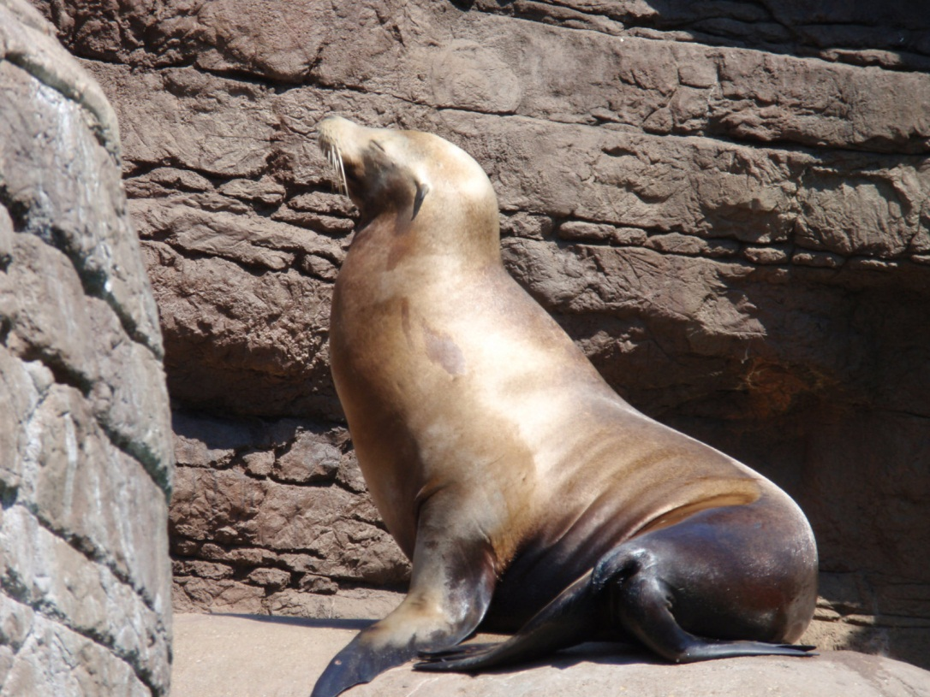
Top 10 Reasons to Visit the Zoo
Elephant baths
Giraffe feedings
Ice cream
Carousel
Penguins
Dolphin show
Shark touch tank
Baby animals
Petting zoo
Sea Lions

Slide 2
Monkeying Around!
A baby monkey playing with some leaves.

Slide 3
Indianapolis Zoo Weather

Slide 4
Indianapolis Zoo Attendance

Slide 5
Our Favorite Zoo
Indianapolis zoo

